Slide 1
Profitability Dashboard – Superstore Sales Analysis
Presented by: Kiruthika Date: 24th October 2025

Slide 2
Objective
Design an interactive dashboard that enables business stakeholders to explore sales and profitability trends across regions, products, and customer segments and make data-driven decisions.

Slide 3
Dataset
Dataset Used: Superstore Sales (Kaggle) Key Fields:
Order Date, Region, Category, Sub-Category
Sales, Profit, Discount
Customer Segment, Product Name
Purpose: To analyze profitability drivers and uncover actionable insights for strategic planning

Slide 4
KPI
KPIs
Total Sales | Overall revenue generated
Total Profit | Net earnings across all transactions
Profit Margin | Profit as a percentage of sales
Monthly Profit Trend | Seasonal performance across years
Top Products by Profit | High-performing items
Segment Contribution | Profit by customer segment

Slide 5
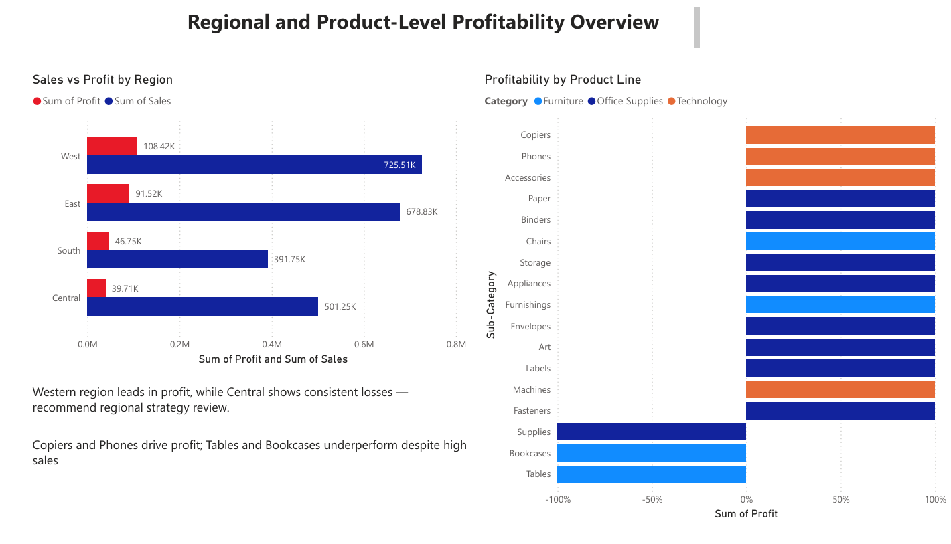

Slide 6
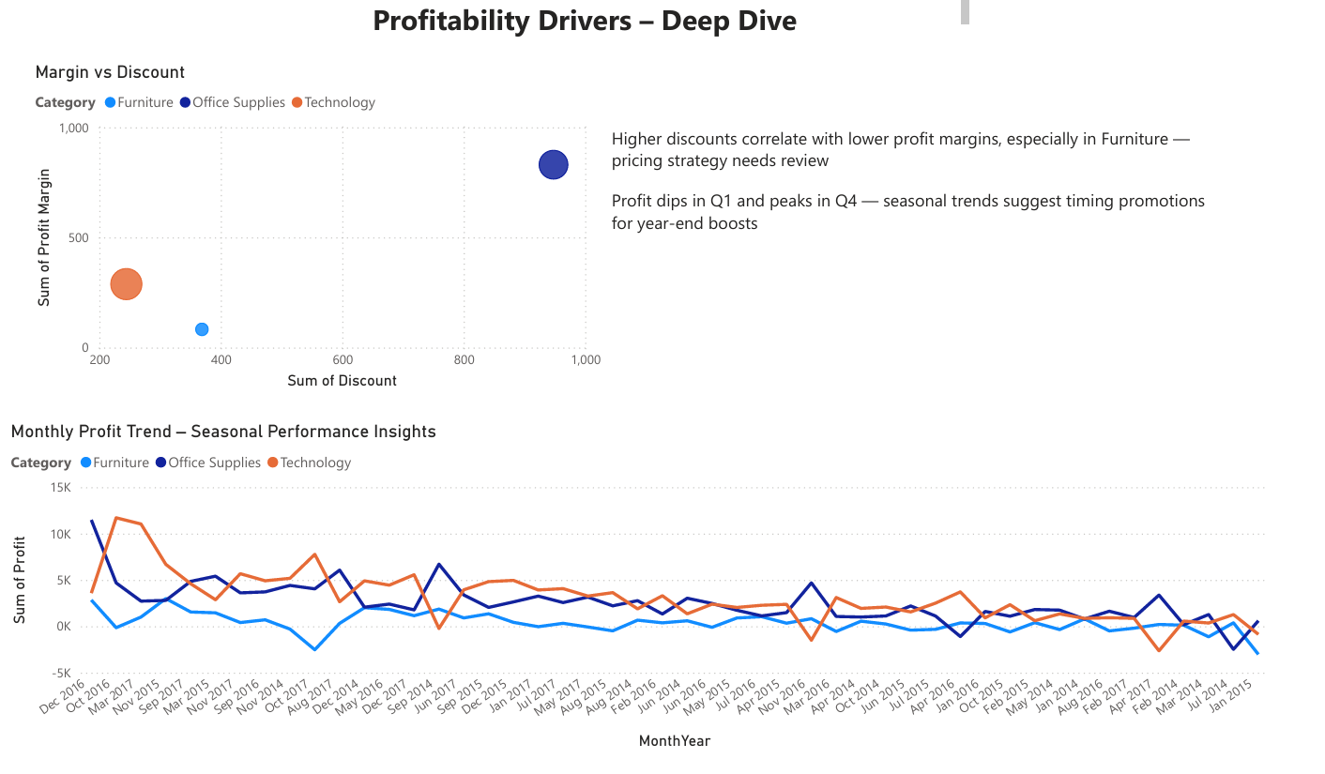

Slide 7
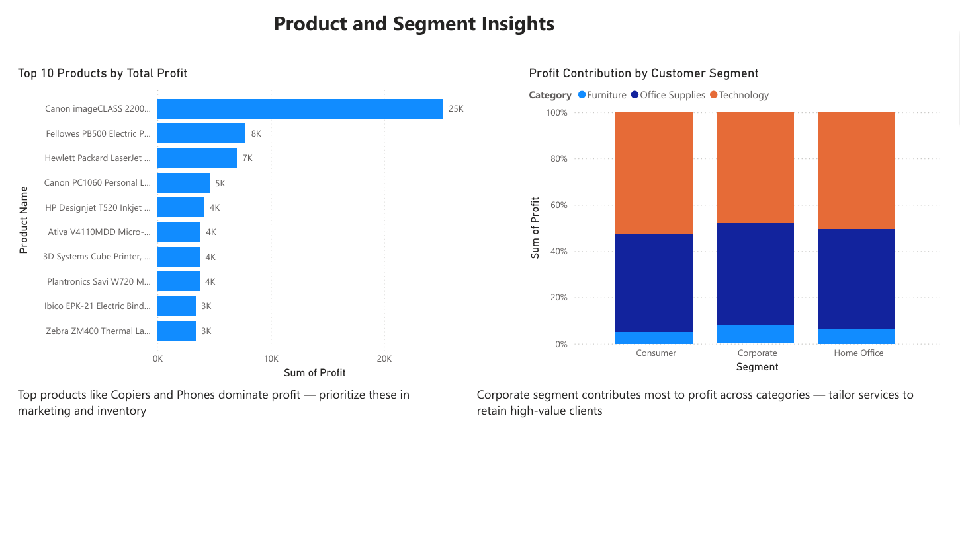

Slide 8
Key Insights
Western region leads in profit; Central underperforms consistently
Copiers and Phones are top profit drivers
Tables and Bookcases show high sales but low profit
Higher discounts reduce profit margins, especially in Furniture
Profit peaks in Q4, dips in Q1 — seasonal trends are strong
Corporate segment contributes most to profit across categories

Slide 9
Recommendations
Revisit strategy for underperforming regions like Central
Prioritize high-profit products (Copiers, Phones) in marketing and inventory
Review discounting strategy, especially for Furniture
Align promotional campaigns with seasonal profit peaks (Q4)
Tailor services and retention efforts for high-value Corporate clients

